Slide 1

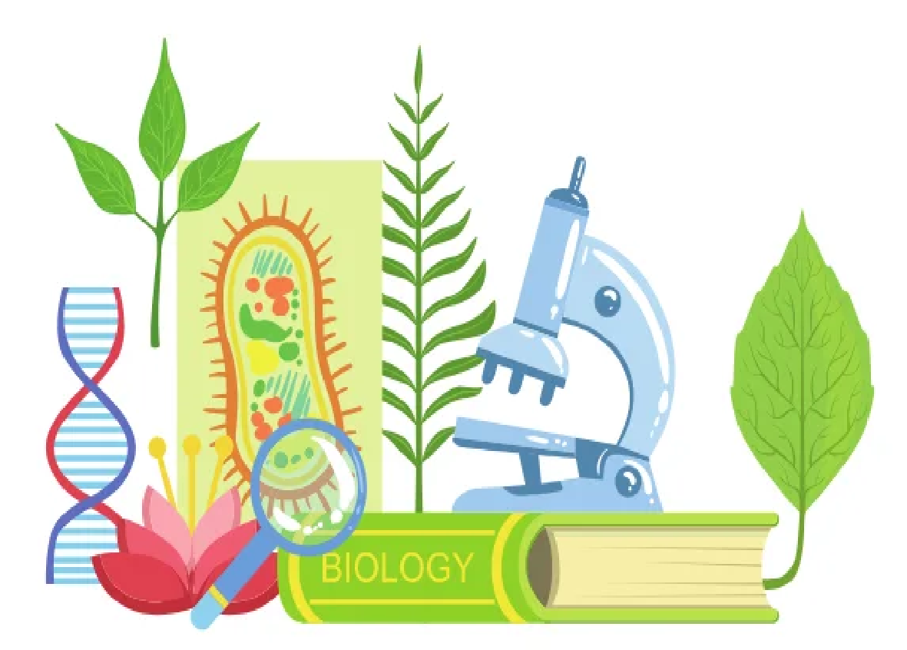
BIOLOGY FOR COMPUTER ENGINEERS- BBOC407
Module -2
APPLICATION OF BIOMOLECULES
By
Dr. Srividya R
Associate Professor, Dept of ISE

Slide 2

OVERVIEW
Carbohydrates in cellulose-based water filters production
PHA and PLA in bioplastics production
Nucleic acids in vaccines and diagnosis
Proteins in food production
Lipids in biodiesel and detergents production
Enzymes in biosensors fabrication, food processing, detergent formulation and textile processing

Slide 3
Carbohydrates in cellulose-based water filters production
What are carbohydrates?
Carbohydrates, or carbs, are sugar molecules.
Body breaks down carbohydrates into glucose.
Glucose, or blood sugar, is the main source of energy for the body's cells, tissues, and organs.

Slide 4
Continued...
There are 3 main types of carbohydrates:
Sugars: They are also called simple carbohydrates because they are the most basic form.
Starches: They are complex carbohydrates, which are made of lots of simple sugars strung together.
Body needs to break starches down into sugars to use them for energy.
3. Fiber: It is also a complex carbohydrate.
Body cannot break down most fibers, so eating fiber can help feel full and make less likely to overeat.
Just like starches, cellulose is another best example for carbohydrates.

Slide 5
Cellulose...
It’s a complex carbohydrate, or polysaccharide, consisting of 3,000 or more glucose units.
It is extremely abundant, easily renewable, and biodegradable.
It’s insoluble in water: Due to inter- and intramolecular hydrogen bonding between hydroxyl groups of the neighboring cellulose chains.
Also, it is difficult to dissolve with common organic solvents.
The best application of cellulose is, Cellulose-based water filters.

Slide 6
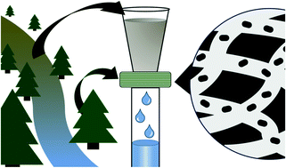
Continued...
Filters based on cellulose pulp fibers have large pores that facilitate water percolation but they do not sufficiently remove bacteria through size exclusion.
Several groups have addressed this issue by incorporating antibacterial metal nanoparticles into cellulose-based water filters;
Silver nanoparticles (AgNPs) and
Copper nanoparticles (CuNPs)
An alternative method to physically remove bacteria from water is:
use positively charged filters that adsorb negatively charged bacteria onto the surfaces of filters

Slide 7
Continued...
This allows negatively charged particles much smaller than the filter pore size to be efficiently removed from water.
Methods used for the same are:
•LBL [Layer By Layer] MODIFICATION
•NITROGEN ANALYSIS
•SEM [ Scanning Electron Microscope]
•FLOW RATE FOR FREE FLOW FILTRATION
•BACTERIAL REMOVAL EFFICIENCY OF FILTRATION
•FILTRATION OF NATURAL WATER SAMPLES
•FLOURESCENCE MICROSCOPY

Slide 8
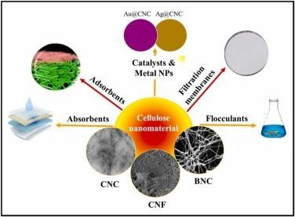
Continued...
Cellulose filter papers are versatile and diverse tools for microfiltration.
They work by trapping particulates within a random matrix of cellulose fibers.
They can be categorized as quantitative or qualitative, depending on their application.
Cellulose based nanomaterials for water treatment.
CNC- Cellulose Nanocrystal
CNF- Cellulose Nanofiber
BNC- Bacterial Nanocellulose

Slide 9
PHA and PLA in bioplastics production
Bioplastics are one type of plastic which can be generated from natural resources such as starches and vegetable oils.
Bioplastics are basically classified as bio based and/or biodegradable.
Not all bio-based plastics are biodegradable and similarly not all biodegradable plastics are bio based.
Bio plastics are said to be biodegradable if they are broken down with the effect of right environmental conditions and microbes.
The bioplastics are considered compostable, if, within 180 days, a complete microbial assimilation of the fragmented food source takes place in a compost environment.
Based upon this, we have PHA and PLA.

Slide 10
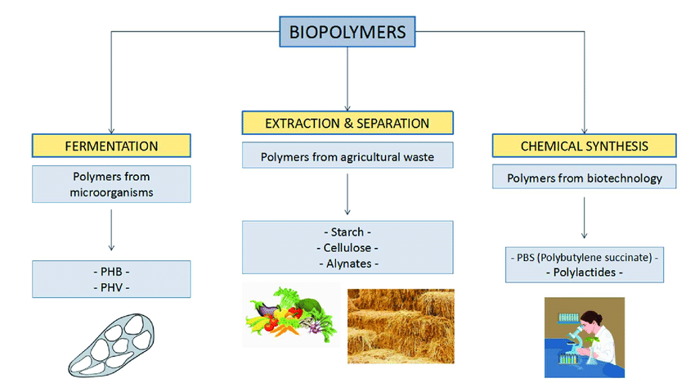

Poly Lactic Acid (PLA) ...
PLA is biobased and biodegradable under industrial composting conditions (at a high temperature, around 58 °C).
It has good mechanical properties, processability, renewability, and non-toxicity.
PLA is considered as one of the most commercially promising bioplastics.
When compared with other biodegradable polymers, PLA has better
    durability,
    transparency, and
    mechanical strength.
Production of biopolymers

Slide 11
Poly Hydroxy Alkanoates(PHA)...
PHAs are a significant polymer family that are 100% bio-based and bio-degradable.
PHAs are microbiologically produced polyesters that have tunable physical and mechanical properties.
This is accompanied by low environmental impact due to their biodegradability and non-toxicity nature.
They are promising candidates for a sustainable future manufacturing.
PHAs' properties can be altered by the selection of bacteria, fermentation conditions, and substrate.
Due to their flexible properties, PHAs can eventually substitute polypropylene(PP), polyethylene (PE), and polystyrene (PS).
NOTE: CA---> Cellulose Acetate

Slide 12
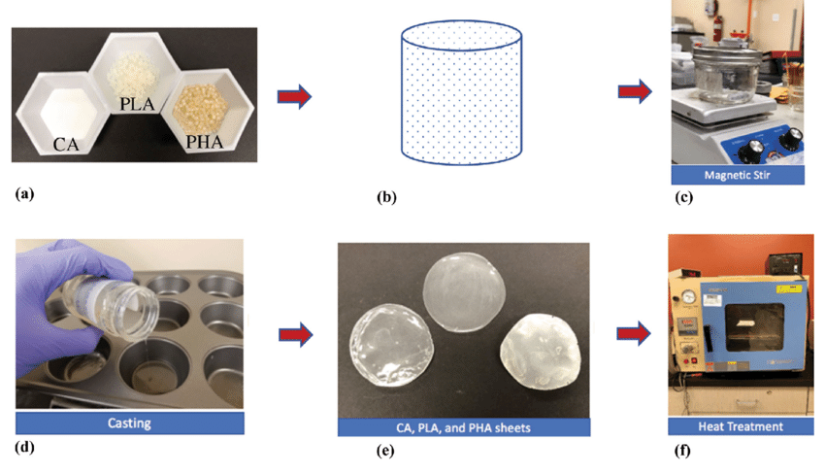
STEPS IN PRODUCING BIOPLASTIC FROM PHA AND PLA

Slide 13
Nucleic acids in vaccines and diagnosis
Nucleic acids are biopolymers, macromolecules, essential to all known forms of life.
The 2 main classes of nucleic acids are:
Deoxyribonucleic acid (DNA) and
Ribonucleic acid (RNA).
If the sugar is ribose, the polymer is RNA.
if the sugar is the ribose derivative deoxyribose, the polymer is DNA.

Slide 14
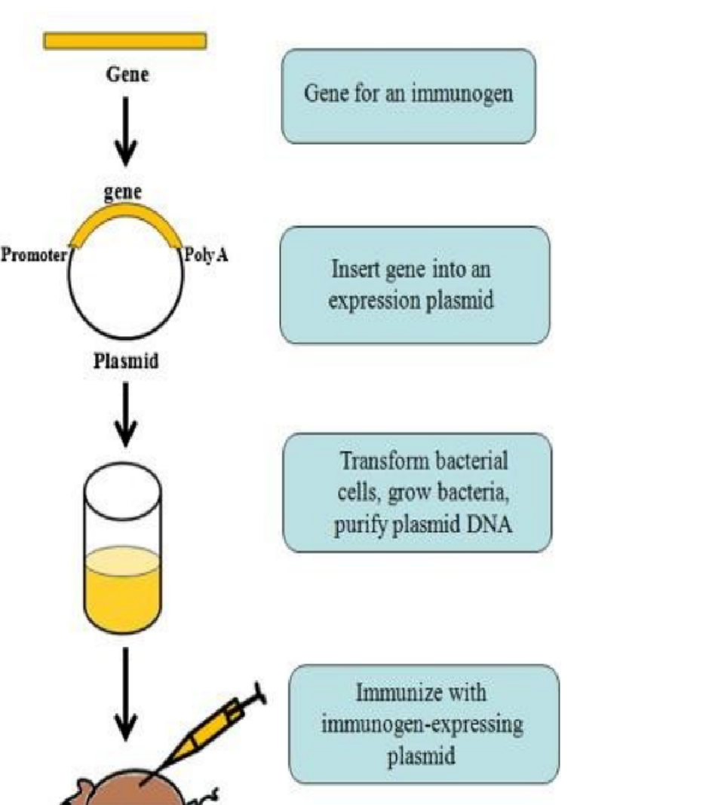
DNA VACCINE FOR RABIES:
Rabies is a preventable viral disease most often transmitted through the bite of a rabid animal.
The rabies virus infects the central nervous system of mammals.
It ultimately causes disease in the brain and death.
Most rabies cases occur in wild animals like bats, raccoons, skunks, and foxes, any mammal can also get rabies.
dna vaccine production

Slide 15
DNA VACCINE FOR RABIES:
1. A DNA vaccine, using a pCl-neo plasmid encoding the glycoprotein gene of rabies virus, was developed for immunity against rabies virus in dogs.
The high rates of therapy failure, indicate the need for timely and improved approaches.
2. DNA vaccination based on lysosome-targeted glycoprotein of rabies virus provides potential platform for preventing and controlling rabies.
Physical, physiological, clinical, immunological, hematological along with histopathology profiles of target organs was monitored to assess the impact of vaccination.
There were no observational adverse effects despite high dose administration of vaccine.
This study indicates safety of vaccines and highlights their potential application.

Slide 16

RNA VACCINES FOR Coronavirus Disease:
COVID-19 is caused by the SARS-CoV-2 virus.
In RNA Vaccine, Messenger RNA, instructs cells, to make a protein that generates an immune response in the body.
Thus producing the antibodies to provide protection against a disease.
It is the basis for the Pfizer/BioNTech, Moderna COVID-19 vaccines and COVAX global vaccine.
mRNA vaccines contain instructions for making the SARS-CoV-2 spike protein.
This protein is found on the surface of the virus that causes COVID-19.

Slide 17
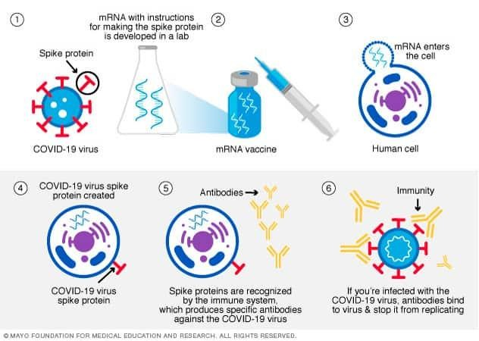

RNA VACCINES FOR Coronavirus Disease
mRNA vaccines contain instructions for making the SARS-CoV-2 spike protein.
These vaccines are given as injection, usually into the muscle.
After the protein piece is made, the cell breaks down the instructions and gets rid of them.
The mRNA never enters the nucleus of the cell, in which DNA is found.
The cell then displays the protein piece on its surface.
Our immune system recognizes that the protein doesn't belong there and begins building an immune response and making antibodies.

Slide 18

FORENSIC-DNA FINGERPRINTING
DNA fingerprinting, is also called
DNA typing,
DNA profiling,
Genetic fingerprinting,
Genotyping, or
Identity testing.
It’s method of isolating and identifying variable elements within the base-pair sequence of DNA.
DNA fingerprinting is a laboratory technique.
It is used to determine the probable identity of a person.
It is based on the nucleotide sequences of certain regions of human DNA that are unique to individuals

Slide 19
FORENSIC-DNA FINGERPRINTING
The procedure for creating a DNA fingerprint consists of following steps:
First, obtain a sample of cells, such as skin, hair, or blood cells, which contain DNA.
Then, extract DNA from the cells and purify.
Then, cut DNA strands at specific points with proteins known as restriction enzymes
The fragments are sorted by placing them on a gel
Gel is subjected to an electric current (electrophoresis): Shorter the fragment, the more quickly it moved towards the positive pole (anode).
The double stranded fragments are then subjected to blotting technique (split DNA into single strands and transfer to a nylon sheet)
The fragments undergo autoradiography in which they are exposed to DNA probes(pieces of synthetic DNA that are radioactive).
A piece of X-ray film is then exposed to fragments, and a dark mark is produced at any point where a radioactive probe is attached.
The resultant pattern of marks could then be analyzed.

Slide 20
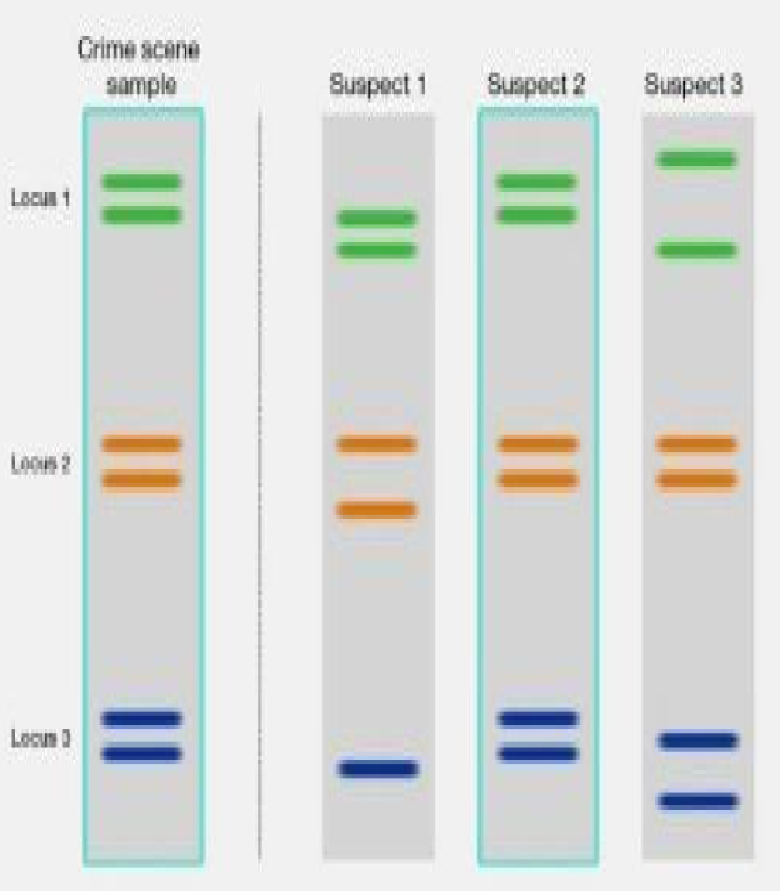

FORENSIC-DNA FINGERPRINTING
The DNA testing process is comprised of 4 main steps, including:
extraction,
quantization,
amplification, and
capillary electrophoresis.
It can be defined as :
comparison of the DNA in a person’s nucleated cells with that identified in biological matter
Biological matter can be found:
at the scene of a crime or
with the DNA of another person for the purpose of identification or exclusion
The application of these techniques introduces new factual evidence to criminal investigations and court cases.

Slide 21
Proteins in food production
Proteins are large biomolecules and macromolecules that comprise one or more long chains of amino acid residues.
Proteins are assembled from amino acids using information encoded in genes.
Each protein has its own unique amino acid sequence that is specified by the nucleotide sequence of the gene, encoding this protein.
The genetic code is a set of 3-nucleotide sets called codons and each 3-nucleotide combination designates an amino acid.
The set of proteins expressed in a particular cell or cell type is known as its proteome.

Slide 22
Continued...
Protein is a key part of any diet.
The average person needs about 7 grams of protein every day for every 20 pounds (9.072 kg) of body weight.
Animal-based foods (meat, poultry, fish, eggs, and dairy foods) tend to be good sources of complete protein.
Plant-based foods (fruits, vegetables, grains, nuts, and seeds) often lack one or more essential amino acid.
Proteins consist of α-lact albumin, β-lacto globulin, serum albumin and immuno globulins.

Slide 23
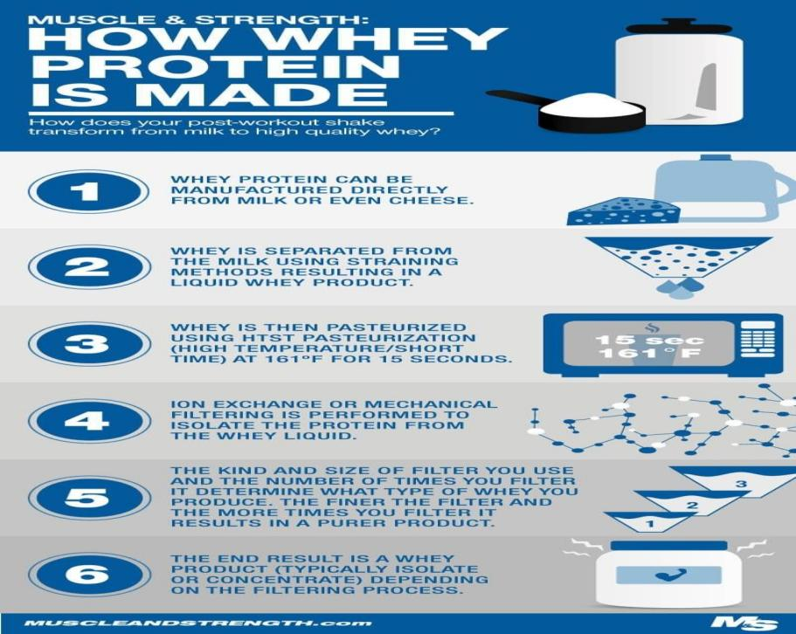
Continued...
WHEY protein is a mixture of proteins isolated from whey (liquid by-product of cheese production)
Whey is left over, when, milk is coagulated during the process of cheese production.
It contains everything, that is soluble from milk, after the pH is dropped to 4.6, during coagulation.
It is a 5% solution of lactose in water.
It contains water soluble proteins of milk as well as some lipid content.

Slide 24
Continued...
WHEY processing can be done by simple drying.
The relative protein content can be increased by removing the lactose, lipids and other non-protein materials.
The primary usage of whey protein supplements is for muscle growth and development.
Eating WHEY protein supplements before exercise will not assist athletic performance.
It will enhance the body's protein recovery and synthesis after exercise.
It increases free amino acids in body's free amino acid pool.

Slide 25
Meat analogues
High moisture extrusion cooking enables the production of fresh, premium meat analogues.
These are texturally like muscle meat from plant or animal proteins.
The appearance and eating sensation are similar to cooked meat while high protein content offers a similar nutritional value.
Meat analogues, can be defined as:
    products that mimic meat in:
    its functionality
    bearing similar appearance
    texture, and
    sensory attributes to meat
Production of meat analogues has been on the increase for healthy, low environmental impact, and ethical meat substitutes.

Slide 26
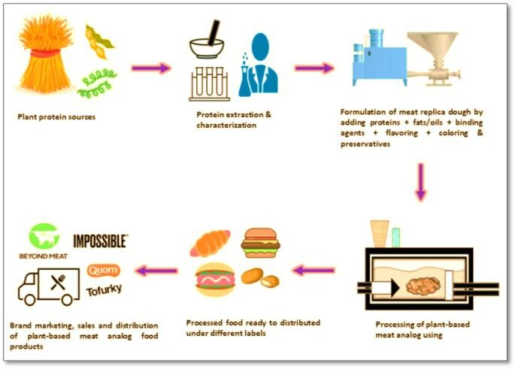
Continued...
The factors that lead to this shift is:
due to low fat and calorie foods intake
flexitarians, animal disease, natural resources depletion, and
reduce greenhouse gas emission.
Currently, available meat analog products are plant-based meat in which, the quality is similar to the conventional meat.
The ingredients used are mainly soy proteins with novel ingredients added, such as mycoprotein and soy leghemoglobin

Slide 27
PLANT BASED PROTEINS
Plant protein is simply a meaningful food source of protein which is from plants.
It includes pulses, tofu, soya, tempeh, seitan, nuts, seeds, certain grains and even peas.
Pulses are a large group of plants, which include chickpeas, lentils, beans and split peas.
Plant proteins are highly nutritious – not only as good sources of protein, but also because they provide other nutrients such as fibre, vitamins and minerals.
By incorporating plant proteins into our diet, such as pulses, peas and nuts, one can easily boost fibre intake.

Slide 28
PLANT BASED PROTEINS
Consumer demand for plant protein-based products is high and expected to grow considerably in the next decade.
Factors contributing to rise in popularity of plant proteins include:
Potential health benefits associated with increased intake of plant-based diets.
Consumer concerns regarding adverse health effects of consuming diets high in animal protein.
Increased consumer recognition of the need to improve, environmental sustainability of food production.
Ethical issues regarding the treatment of animals and
General consumer view of protein as a “positive” nutrient.
There is higher health and physical functional benefits in plant-based protein diets.
But nutritional quality of plant proteins may be inferior in some respects relative to animal proteins.

Slide 29
Lipids in biodiesel and detergents production
Lipids, are important biomolecule.
The functions of lipids include storing energy, signaling and acting as structural components of cell membranes.
Lipids have applications in the cosmetic, food industries and in nanotechnology.
Within the body, lipids function as:
an energy reserve,
regulate hormones,
transmit nerve impulses,
cushion vital organs, and
transport fat-soluble nutrients.

Slide 30
Lipids in biodiesel
Lipid obtained from food waste was used as a potential feedstock for biodiesel production.
Biodiesel production used both a chemical catalyst and a biocatalyst.
Biodiesel demonstrates an animal fat-based or vegetable oil based diesel fuel.
Biodiesel is generally made by esterifying lipids (e.g. vegetable oil, and animal fat) with an alcohol generating fatty acid esters.
Biodiesel can be used singly or blended with gasoline in any proportions.
Biodiesel blends can also be utilized as heating oil.

Slide 31
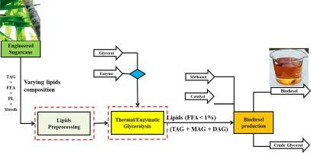
Lipids in biodiesel
Biodiesel production

Slide 32
Lipids in detergents production
Lipid also has an interesting application in cleaning agents.
Considering the case of DETERGENTS.
The hydrophobic end of the phospholipid bilayer stays away from the water.
This avoids the dissolution of cell membrane in water.
But the detergent can bind to the hydrophobic end of the cell membrane and form a solution with water.
Thus breaking the cell membrane barrier.

Slide 33
Lipids in detergents production
Detergent monomers solubilize membrane proteins by partitioning into the membrane bilayer.
With increasing amounts of detergents, membranes undergo various stages of solubilization.
The initial stage is lysis or rupture of the membrane.
Lipids have the same general structure as detergents.
Lipids differ from detergents in the:
Shape of the monomers
Type of aggregates formed in solution, and
Concentration range required for aggregation

Slide 34
Enzymes in biosensors fabrication
Enzymes are proteins that help speed up metabolism, or the chemical reactions in our bodies.
Our bodies naturally produce enzymes.
6 kinds of enzymes are as follows:
Hydrolases,
Oxidoreductases,
Lyases,
Transferases,
Ligases and
Isomerases.

Slide 35
Enzymes
Enzymes perform the task of lowering a reaction's activation energy.
Enzymes bind to reactant molecules and hold them such that:
the chemical bond-breaking process and
bond-forming processes take place more readily.
Biosensors represent a fast, precise and continuous monitoring of analytes due to:
their high specificity,
simplicity, and
scalability,
they are enzyme-based
Enzymes have the ability to detect lower analyte concentration limits.
So enzymes are used in biosensors.

Slide 36
Enzymes in biosensors fabrication
Biosensors are employed in applications such as:
disease monitoring
drug discovery and
detection of pollutants, disease-causing micro-organisms and markers
Various types of biosensors being used are:
enzyme-based
tissue-based
immunosensors
DNA biosensors and
thermal and piezoelectric biosensors.
There are wide variety of enzymes used in biosensors.
One such enzyme is glucose oxidase, mainly in amperometric glucose biosensor.

Slide 37
GLUCOSE OXIDASE IN BIOSENSORS
Glucose oxidase (GOx) is widely used due to its better stability and relatively inexpensive.
GOx catalyses the redox reaction and transfer electrons from enzyme active sites to electrode for glucose level analysis in blood samples.
Amperometric glucose biosensor was fabricated by immobilizing GOx.
GOx the most popular enzyme:
it’s used for glucose detection,
it’s able to reduce oxygen to hydrogen peroxide
it transforms glucose to d-glucono-1 and 5-lactone.
Quantification of glucose can be achieved based on either:
the detection of hydrogen peroxide produced or
the oxygen consumed.

Slide 38
LIGNOLYTIC ENZYME IN BIO BLEACHING
Ligninolytic enzymes play a key role in degradation and detoxification of lignocellulosic waste in environment.
The major ligninolytic enzymes are:
laccase,
lignin peroxidase,
manganese peroxidase, and
versatile peroxidase.
Ligninolytic fungi and enzymes have been applied recently in the production of second-generation biofuels.

Slide 39

LIGNOLYTIC ENZYME IN BIO BLEACHING
White-rot fungi are the main producers of lignin-oxidizing enzymes.
These fungi secrete:
a number of oxidative enzymes and
some previously unknown substances into their environment
Hence affecting a slow but continuous degradation.
The most important lignin-oxidizing enzymes are:
lignin peroxidases
manganese peroxidases and
laccases
Lignin peroxidase and manganese peroxidase appear to constitute a major component of the ligninolytic system.

Slide 40
Application of Enzymes in Food Processing
Some of the enzymes generally employed in food industry are listed below:
Alpha-amylase: It is used to solubilize the carbohydrates found in barley and other cereals used in brewing.
Beta-glucanase: Breakdown of glucans in malt and other materials
Lipase: Used to shorten the time for cheese ripening.
Papain: It is widely used as a meat tenderizer.
Chymosin: Helps in the curdling of milk by breaking down kappa-caseins in cheese making.

Slide 41
Application of Enzymes in Food Processing
6. Microbial proteases: Used in the production of fish meals, meat extracts, texturized proteins, etc.
7. Pectinase: Treatment of fruit pulp to facilitate juice extraction. It also helps in the clarification and filtration of fruit juice.
8. Lactase: Additive for dairy products for individuals lacking lactase.
9. Glucose oxidase: Conversion of glucose to gluconic acid to prevent Maillard reaction (reaction that gives browned food a particular flavor) in products caused by high heat used in dehydration.
10. Cellulase: Conversion of cellulose waste to fermentable feedstock for protein production.

Slide 42
Application of Enzymes in textile processing
Some of the applications are as follows
Enzymatic desizing: Amylases are used to remove starch-based size for uniform wet processing in the textile industry.
These enzymes are specific for starch, removing it without damaging to the support fabric.
Enzymatic Scouring: Scouring is the removal of non-cellulosic material from the surface of cotton.
Enzymatic Bleaching: It decolorizes natural pigments and gives pure white appearance to fibers.
Biopolishing : It eliminates micro fibrils of cotton using cellulase enzyme.
It brings the fabric a cleaner surface, a cooler, lustre and softer feel.

Slide 43
THANK YOU

